Slide 1
Blackjack
KANISHK KARGUTKAR
GAURAV MARATHE
ADITYA KAWALE
DHRUVKUMAR MISHRA

Slide 2
contents
Introduction
What Is Blackjack?
Project Aim and Objective
Software and hardware requirements
Flowchart
Module Description
Screenshots
Limitations
Thank You!

Slide 3
Introduction
Blackjack is a card game played between two people, the player and the dealer.
The goal is to achieve the maximum possible score (21) without going ‘bust’ (Above 21).

Slide 4
Project Aim and Objective
The Aim of this project is to create a working BlackJack Player game that will help the user learn to play according to the basic strategy charts.
The objective is to create a system that utilizes multiple tools and wraps them together into a functioning website.
The game should be user friendly and it should follow the standard Blackjack rules to provide an enjoyable gaming experience.
The website must use a database to store and retrieve information for the client and server as required.

Slide 5
Software and hardware requirements
Software requirements
Operating system – Windows 10, Ubuntu 14.4+ OSX Yosemite 10.10
Any IDE to edit the code
XAMPP server
Updated browsers which support CSS3 and HTML5
Hardware requirement
HDD : 100MB
RAM : 128 MB
CPU : Intel Pentium 4 or later

Slide 6
programming languages
front end:
back end:
HTML
CSS
JAVASCRIPT
MySQL
PHP
JAVASCRIPT

Slide 7
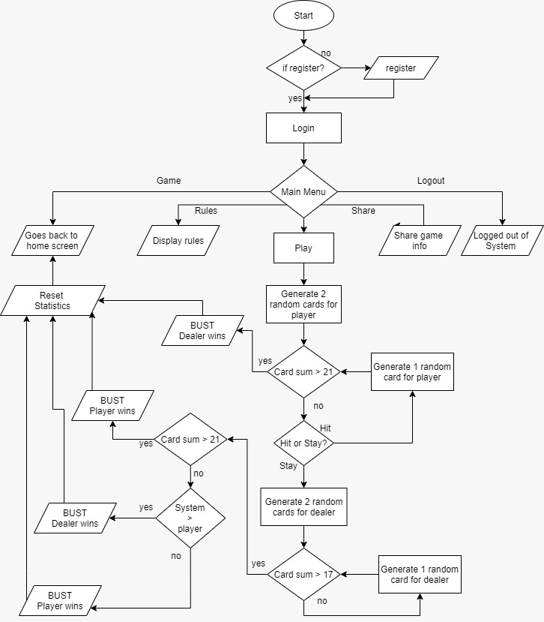
flowchart

Slide 8
Module Description (Registration and login)
Register.html : If the user is new to the game, then the player gets registered here. Username, Email, Address and Password is to be entered by player.
validate.html : Works on the login form by verifying if the user has inputted the correct username and password before allowing him to login.
logout.php : Allows the user to log out of the system.
User_details.sql : A manually programmed database file which can be imported on the server to run the website locally through XAMPP.

Slide 9
Module Description (Registration and login) continued
index.css : All front end CSS is stored here.logout.html : User gets logged out of the system.
index.php : The actual website which runs through XAMPP.

Slide 10
Module Description (Game Algorithm )
Deck.js : The BlackJack game is coded here.
shuffle(): Shuffles the deck of cards using Durstenfeld’s shuffle algorithm.
setValue(): Sets a score to the card object.
createDeck() : Creates a deck of cards using the card objects.
checkVictory() : Finalizes and checks if either the user or the dealer has successfully passed one of the given victory conditions.
disableButtons(): Disables specified HTML buttons.

Slide 11
Module Description (Game Algorithm ) continued
checkBustPlayer() and checkBustDealer() : Checks if player or dealers have busted before returning a value to checkVictory().
playerTurn and dealerTurn() : Places a card inside the div element for either the dealer side or player side depending on their turns.
playerHand and dealerHand() : Pops a card from the deck to and places it inside either the players hand or dealers hand depending on their turns.
playerStand() : Checks if player is ready to place his hand down then this function checks who won.
startGame() : The function which runs when the PLAY button is clicked.

Slide 12
Screenshots

Slide 13
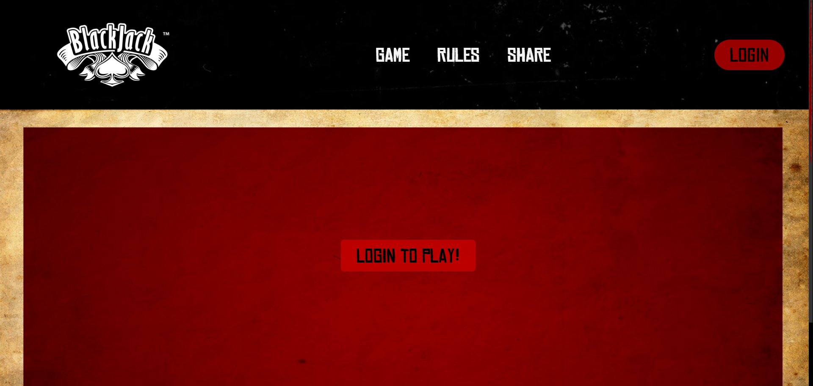

Slide 14
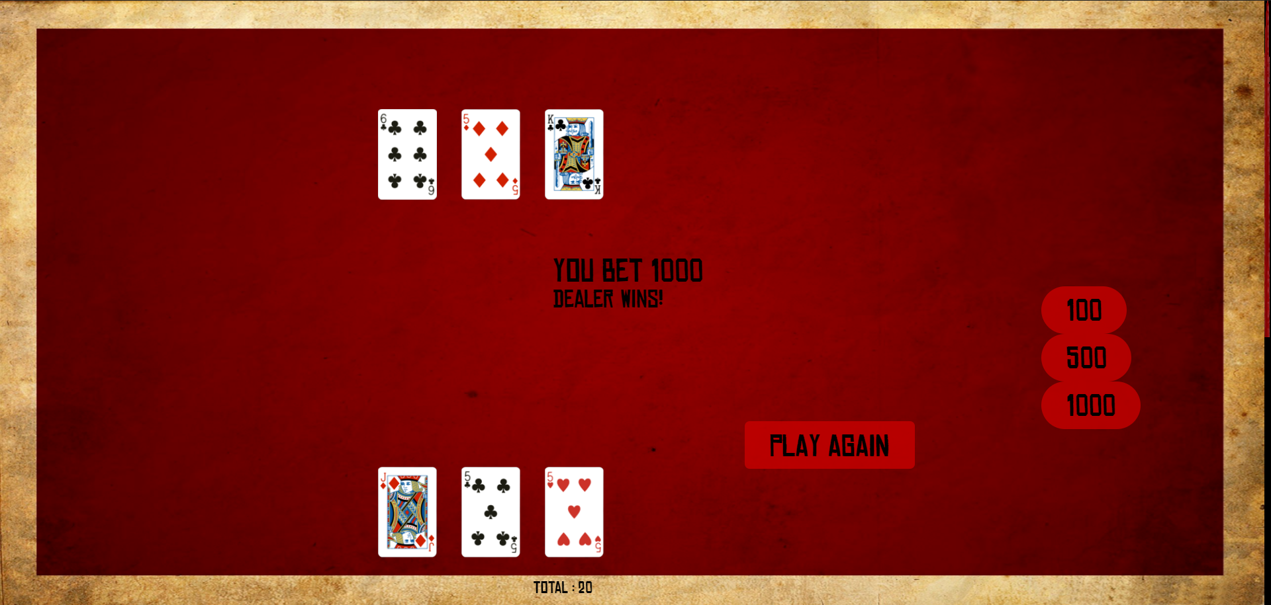

Slide 15
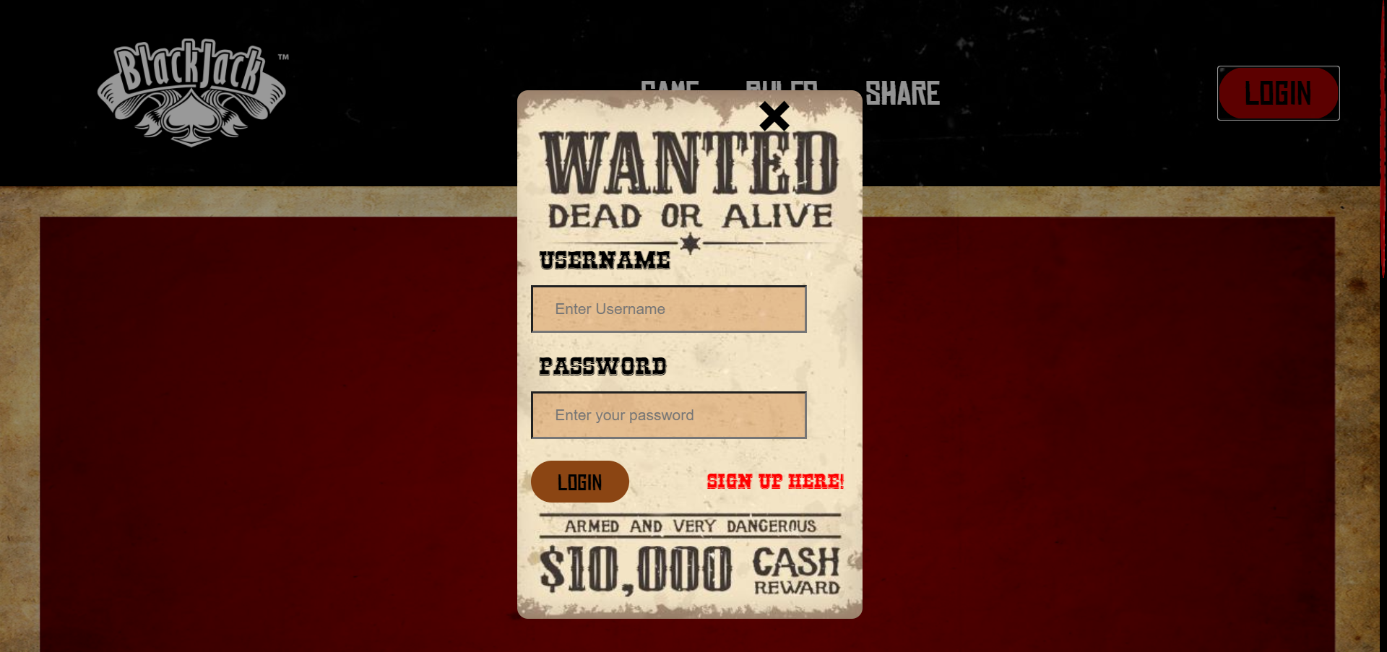

Slide 16
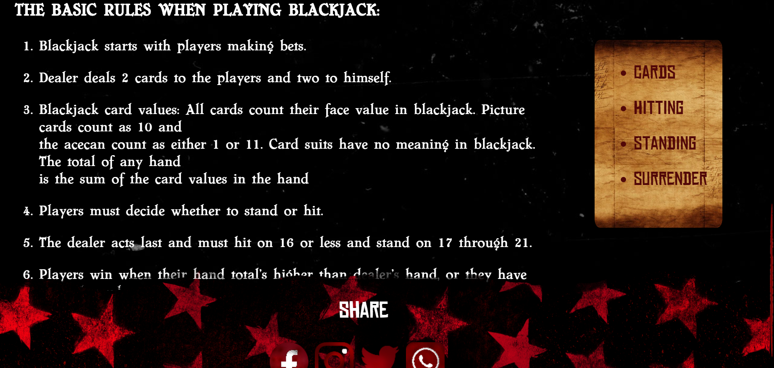

Slide 17
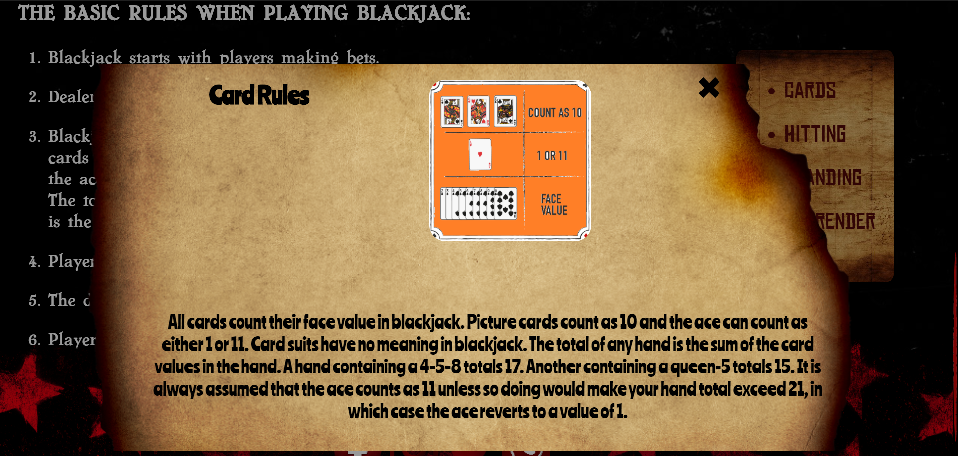

Slide 18
Limitations
Proposed game consists of only a single deck.
No real money is involved.
Proposed game requires an internet connection unless run locally.
The game lacks certain security feature for login/register.
The website elements some times do not scale with certain monitor resolutions causing text and image distortions.
There is no special PUSH concept for draws.
The user cannot change his username and password once they are sent to the database.
The above features is not implemented due to design issues on the login popup.

Slide 19
Enhancement
Implement possibility to play multiple decks of cards to emulate modern day casino rules.
Implement a proper security model for login/register.
Implement multiple rule sets and create the ability for the player to change between them.
Have every element on the front-end scale properly with a user’s monitor.
Use better scripting tools such as jQuery, bootstrap for interaction between front-end and back-end.

Slide 20
Any questions?

Slide 21
Thank you!

